Slide 1
Data Applications to Enteral Feeding
By Austin Bermingham & Kyle Borgemenke

Slide 2

Current Problems
Many feeding pumps such as Vesco Q pump lack a data export function.
Limit the ability of providers and caregivers to monitor success.
  Only last feed information is stored.

Slide 3

Goals
Empower Providers & Caregivers to make Data Driven Decisions to Feeding Problems

Slide 4

Overview of Solution
Integrating a low-energy Bluetooth module to facilitate export.
Developing a database endpoint to store data.
Creation of a Semantic Model to Show Relationships.
Generation of Data Visualizations that can inform both Caregivers & Providers.

Slide 5
Overview of Solution: Walkthrough
Integration of Bluetooth Module
Export to Phone
Export to Cloud
Connection to Consumer & Provider Endpoints
Connection to Data Visualization Tools

Slide 6
Endpoints for Consumption
Caregivers & Homecare: Development of a Personalized App that will give general overview and concerns to caregiver.
Provider Directed Care: Export of patient information to centralized health databased (e.g. MyChart) to allow for proactive clinical decisions.
  Built on same principles as remote monitoring for juvenile diabetes to allow for independence while still allowing for medical tracking.

Slide 7
App Overview
Aubermingham.github.io/biohacks26/
Link here

Slide 8
Provider Overview

Slide 9
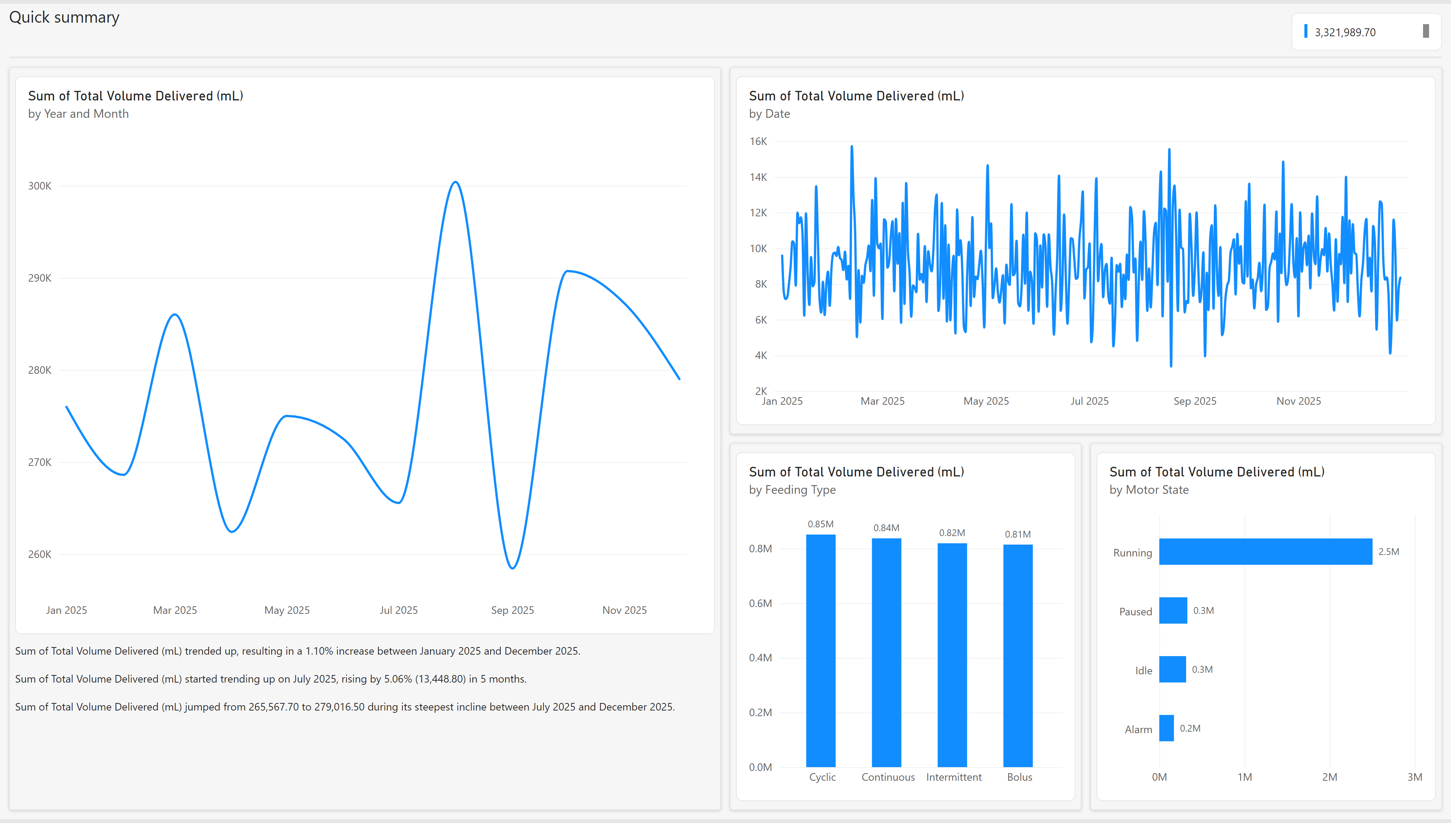
Provider Overview

Slide 10
Questions

